Slide 1


CSR ODOO CRM TRAINING

Slide 2

AGENT CRM BACKGROUND
What is Odoo?
All-in-one management software that offers a range of business applications that form a complete suite of enterprise management applications. Some of the modules in Odoo are CRM, website, e-commerce, billing, finance and accounting, manufacturing, warehouse and inventory, project management, HR, among others.
KOKO Networks has developed and deployed a Customer Relationship Management tool on Odoo, to record activities of the TDR, RM, Customer Service and Technician teams as part of the agent process.

Slide 3
IMPORTANCE OF A CRM FOR AN ORGANIZATION
CRM or Customer Relationship Management is a system that aims to improve the relationship with existing customers, find new prospective customers, and win back former customers.
Acquisition. A CRM system is useful in acquiring new customers, as well as maintaining existing customer relationships. The process first starts with identifying a customer and maintaining all the corresponding details into the CRM system which is also called an ‘Opportunity of Business’. The Sales and Field representatives then try getting business out of these opportunities by sophistically following up with them and converting them into a winning deal. All this is very easily and efficiently done by an integrated CRM system.
Learning. CRM helps businesses learn about their customers, including who they are and why and when they purchase your products. This allows businesses to better anticipate their customers' needs and, as a result, fulfill them. Effectively using customer relationship management can also provide a strategic advantage. Well organized customer data helps companies select the correct recipients for promotions and new products.
Organization. In a CRM. opportunities details are captured (name, contact person, contact number, address etc). Opportunities are organized into different stages of a pipeline flow, with activities and interactions that have happened or are planned for each stage (pitching, demo, installation, inspection). Hence it is very easy for track an opportunity accordingly, allowing businesses to become more efficient. NB: GARBAGE IN, GARBAGE OUT.
Optimization. Finally, CRM software allows businesses to optimize their customer interactions. By simplifying and streamlining many of the more complex customer interaction processes, CRM increases customer satisfaction.

Slide 4
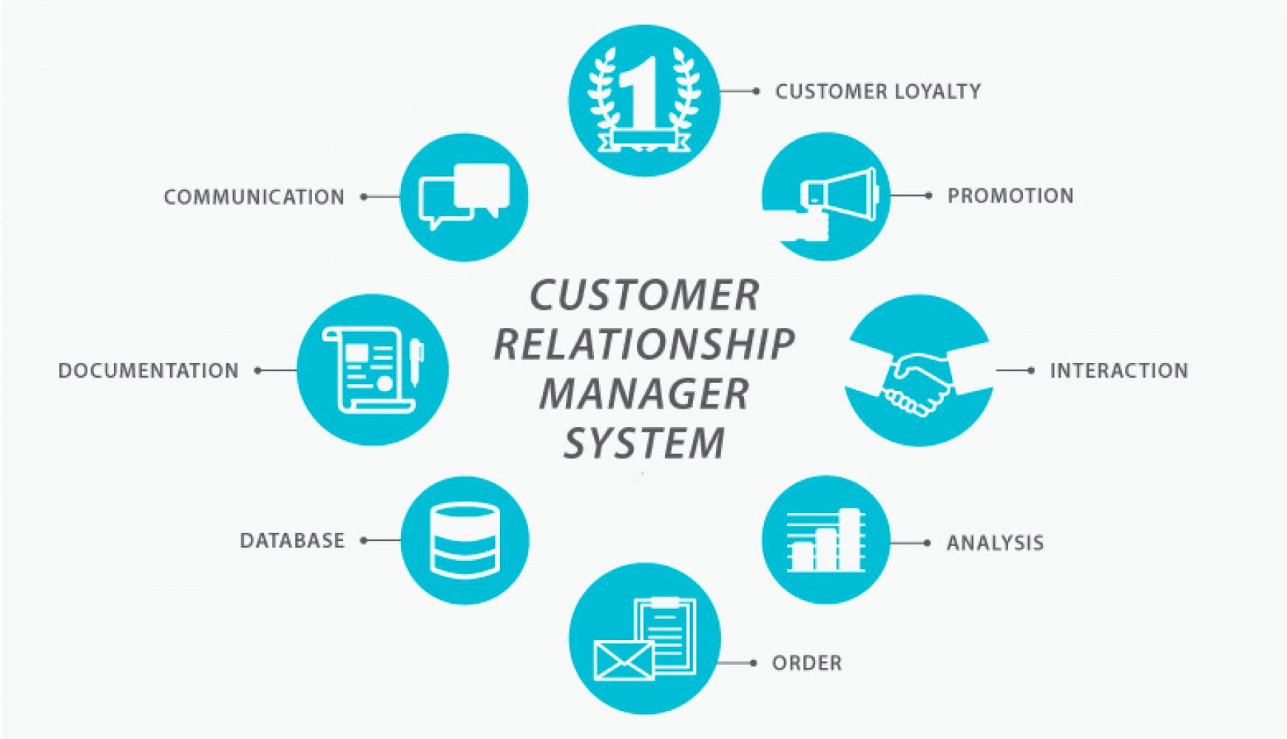

Slide 5
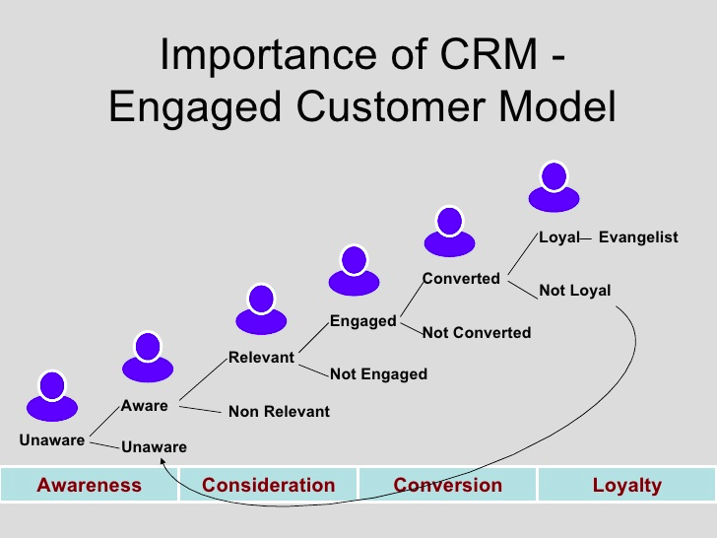

Slide 6
ODOO CRM SYSTEMS AND STRUCTURE
SYSTEM | ROLE | FUNCTION
Odoo CRM | Customer Service TDR RM Inspection Team | Creation Follow Up Scheduling TDR Tasks Inspection Modifications Rescheduling Reservation Fee (Deposit) Balance Payment Document Attachment Won / Lost Reasons Activities Internal User Notifications DataBase
TDR TASK APP | TDR | TDR Task Image Attachments GPS Location Rescheduling

Slide 7
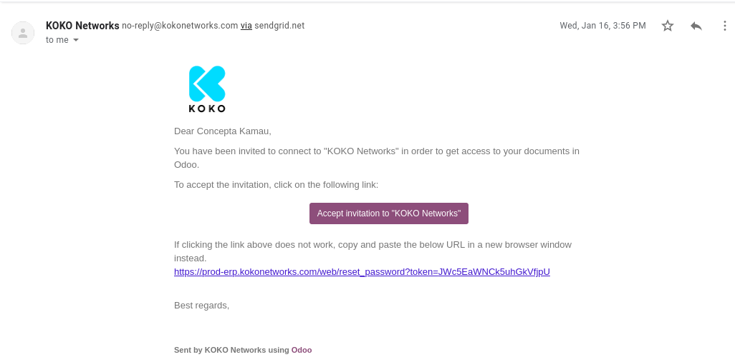
ACCESSING ODOO CRM
Invitation email to login to Odoo:

Slide 8
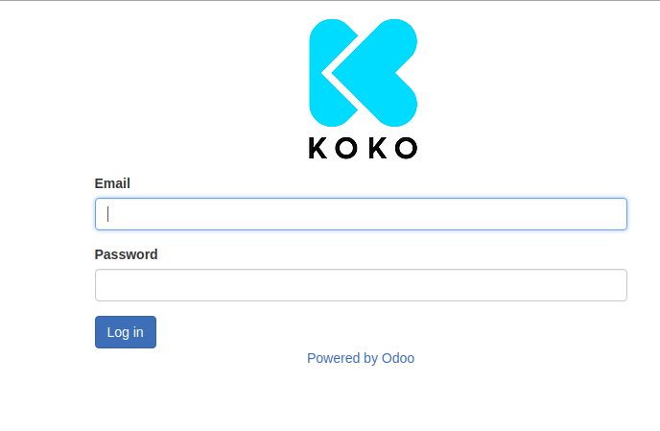
ACCESSING ODOO CRM
Username (company email address): c.kamau@kokonetworks.com
Password: **********
Must be at least 8 characters long, with an upper and lower case letter, numbers and symbols. You cannot use the last 3 passwords

Slide 9
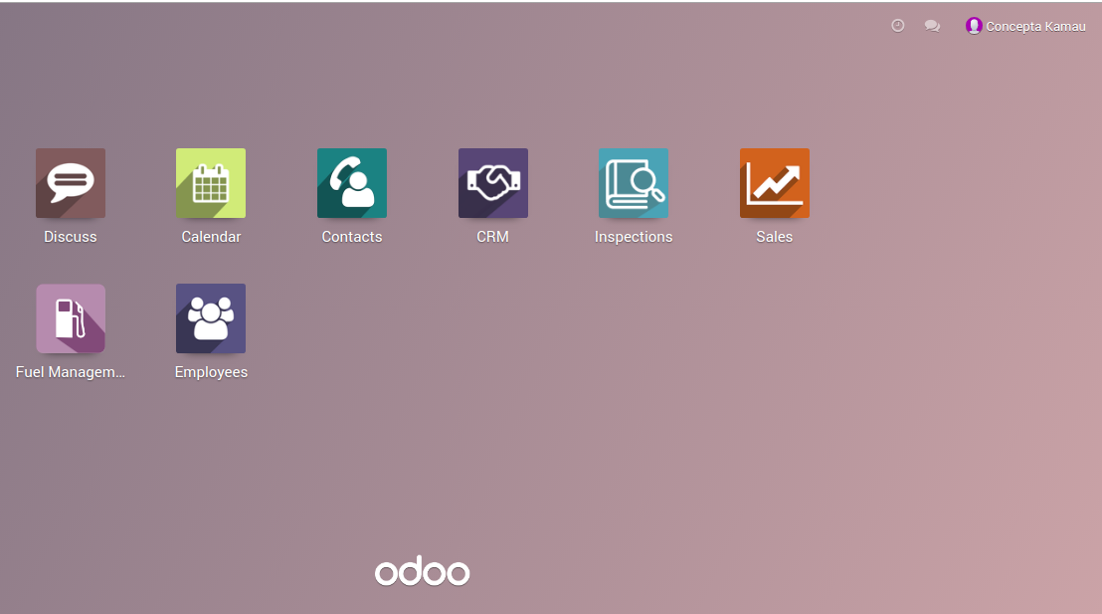
HOME SCREEN
Screen that you seen after Log in. CRM Menu gives access to all Agent opportunities

Slide 10
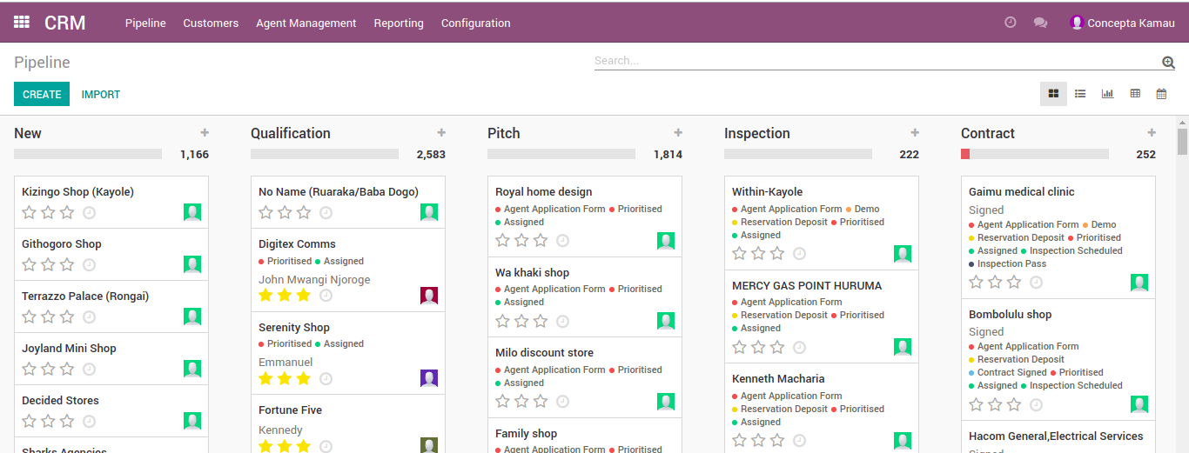
MENU: CRM
CRM menus are Pipeline, Customers, Agent Management, Reporting. This views are dependant on permissions that you have in ERP- RM, TDR, Sales Manager, Legal.
The different stages have a corresponding number of records in it.
Notes:
Discuss CRM Menus:
Pipeline- all opportunities are tracked from new to contract (when a lead is won). All interactions between KNK (TDR, AX/CX, Marketing) are recorded for each opportunity.
Customers: This is where all customer information will be
Agent Management- where TDRs schedule their tasks, Sales meetings are recorded and Inspections are scheduled and recorded
Reporting- to generate reports.
In Pipeline we have various stages:
New- for any new opportunities identified by TDR
Qualification- this is where opportunities are quickly assessed and prioritized based on the TDR task scores/ survey
Pitch- Meetings are held with the Agent to discuss and propose the KP idea, an application form is filled and a deposit is paid by the agent
Inspection- this is where inspection is done and the results recorded to determine if the agent physical location is viable for setting up of a KP
Contract- If viable, the agent is offered a contract to accept/decline

Slide 11
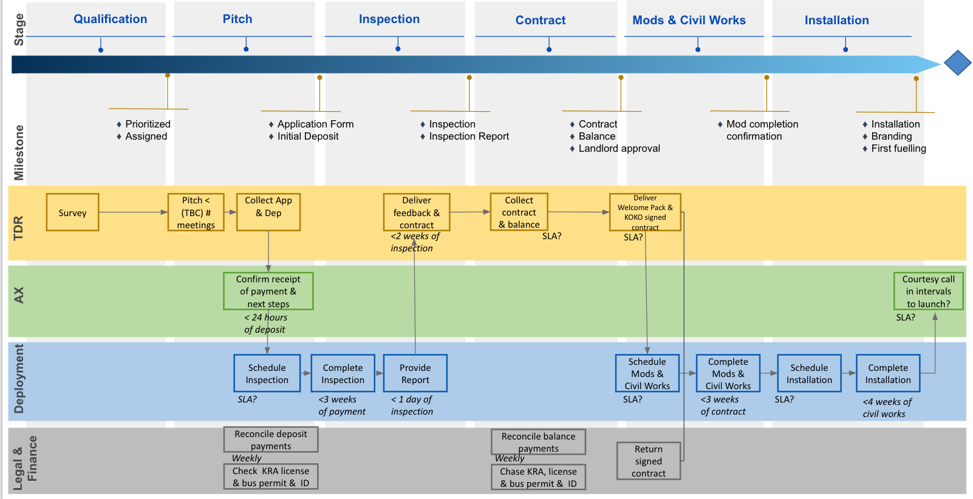
PIPELINE MANAGEMENT ACTIVITIES
Notes:
TDR = face to agent & lead in the journey from qualification to installation (mission = lead Agent through sales process up through installation)
AX = back-up support for agents + validation of TDR process adherence (mission = ensure consistent and positive Agent experience)
Deployment = technology setup and delivery (mission = prepare shop for installation + install KP effectively)

Slide 12
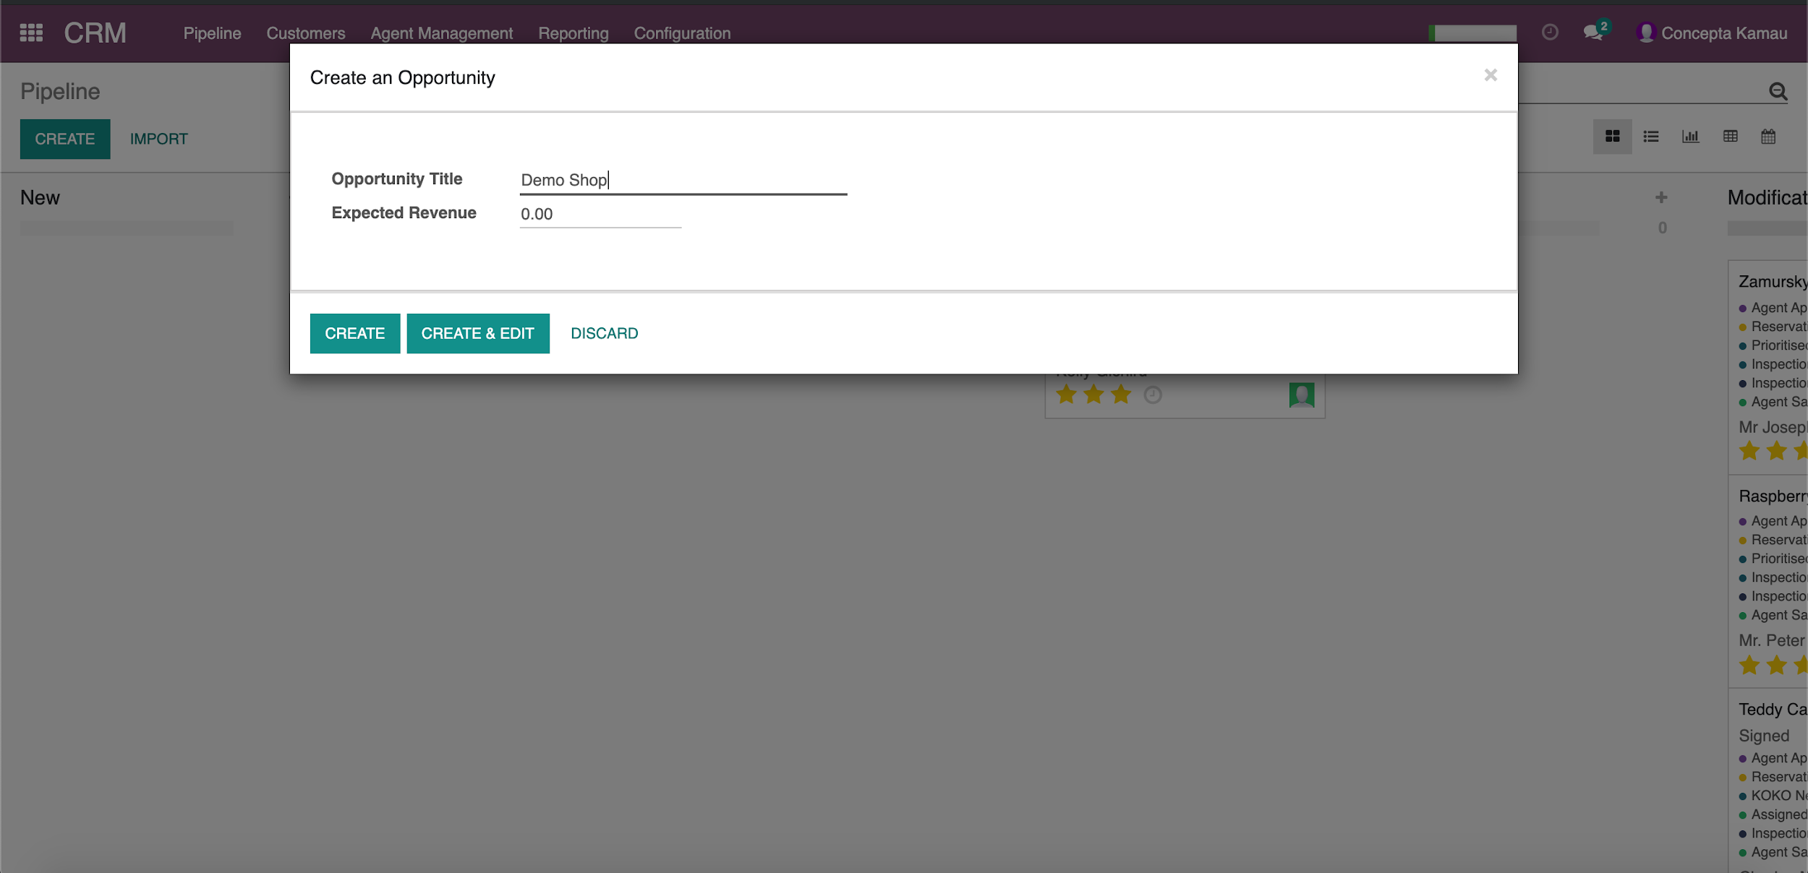
CREATE A NEW OPPORTUNITY
To create a new opportunity, click on Create→ Enter Opportunity Name →Create and Edit:

Slide 13
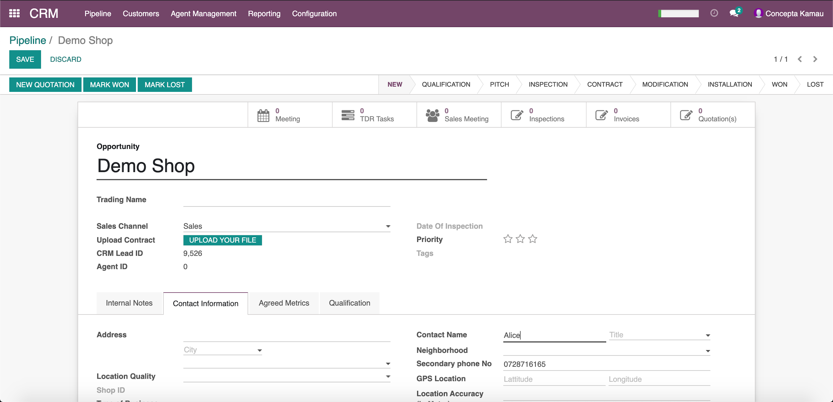
CREATE A NEW OPPORTUNITY
Enter details Opportunity Name. In tab “Contact Information” enter contact name. Click Save
The opportunity is moved from New to Qualification where it will be assessed for suitability.

Slide 14
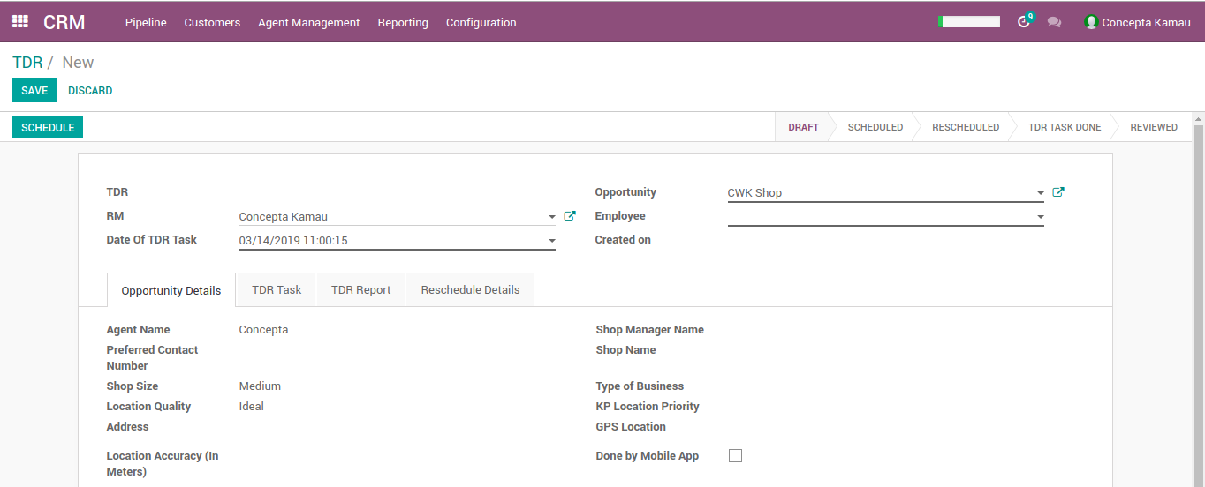
QUALIFICATION- TDR TASK
The TDR task is done on the mobile app installed on the tablet and additional information on an
opportunity is captured and scored calculated.
Under Agent Management→ TDR Task→ Create (enter date of task, RM, Employee (TDR) and opportunity name)→ Schedule→ Save)

Slide 15
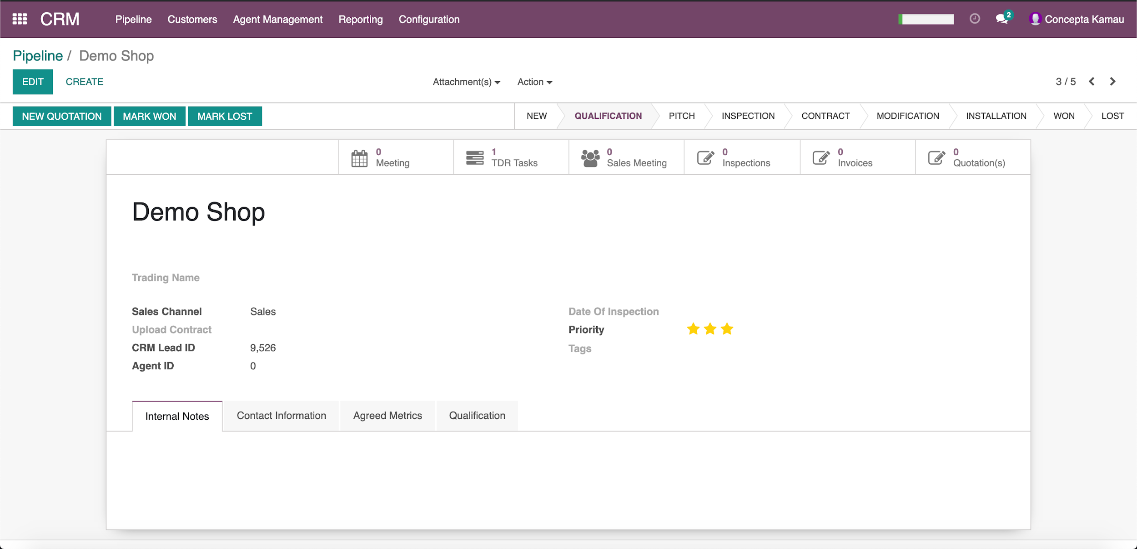
TDR TASK REVIEW
The RMs view the TDR task after it has been submitted, by going to the opportunity and in the tabs at the top, click on TDR task

Slide 16
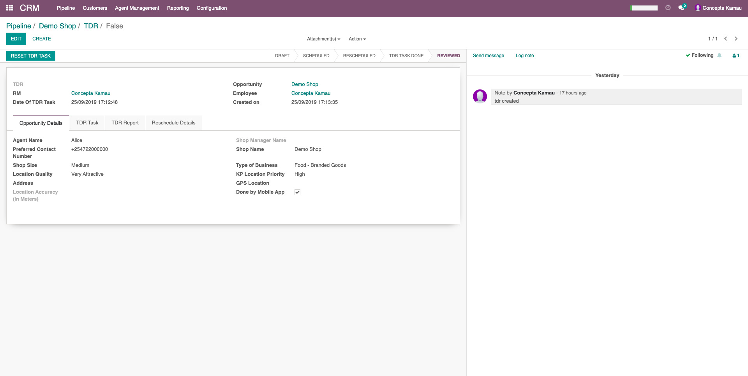
TDR TASK REVIEW
Ensure the “Done by mobile app” in “Opportunity Details” tab has been checked before completing review.

Slide 17
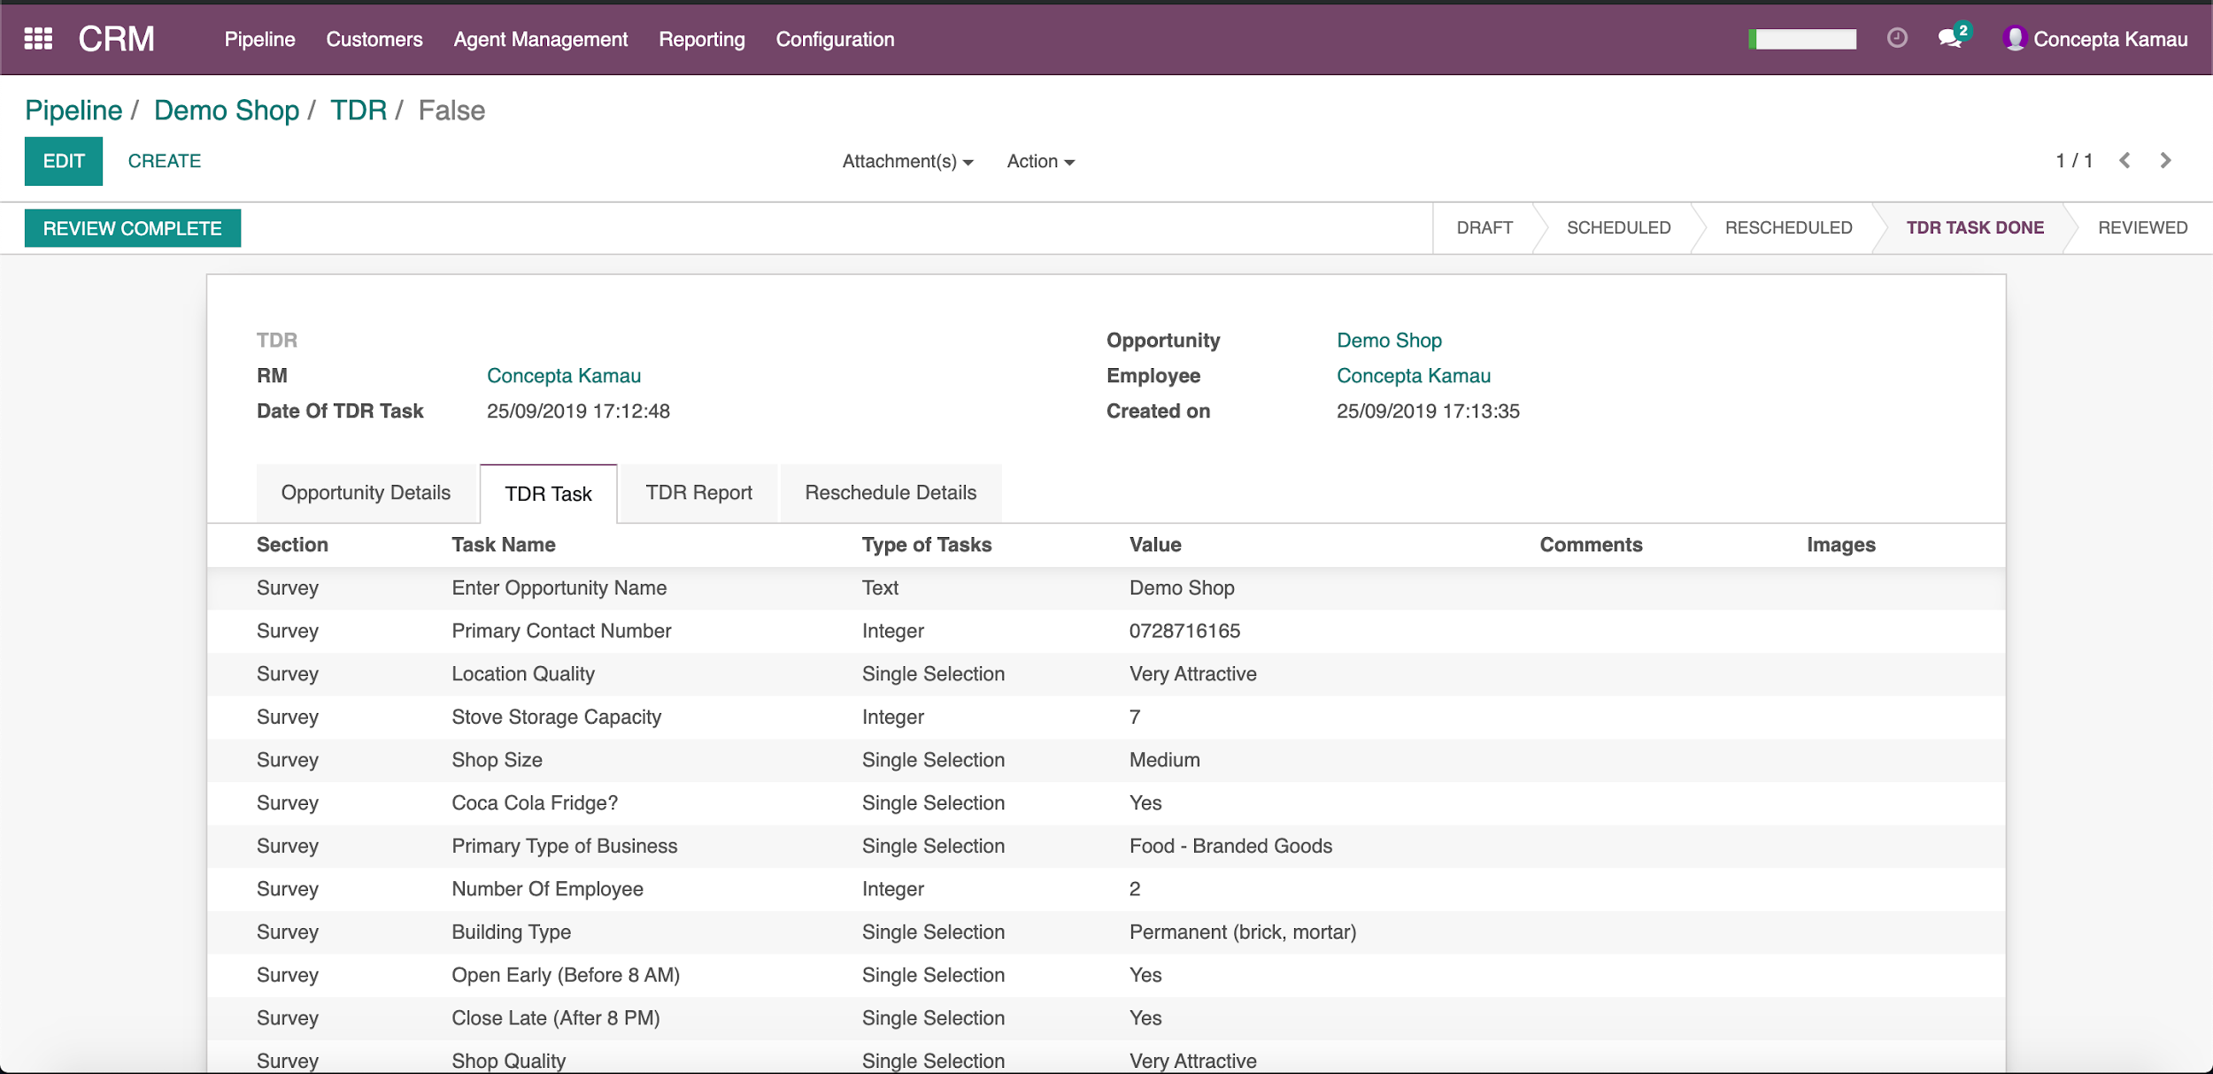
TDR TASK REVIEW
The RMs view the TDR task after it has been submitted in the opportunity.
This changes the state of the TDR task from “TDR Task Done” to “Reviewed”

Slide 18
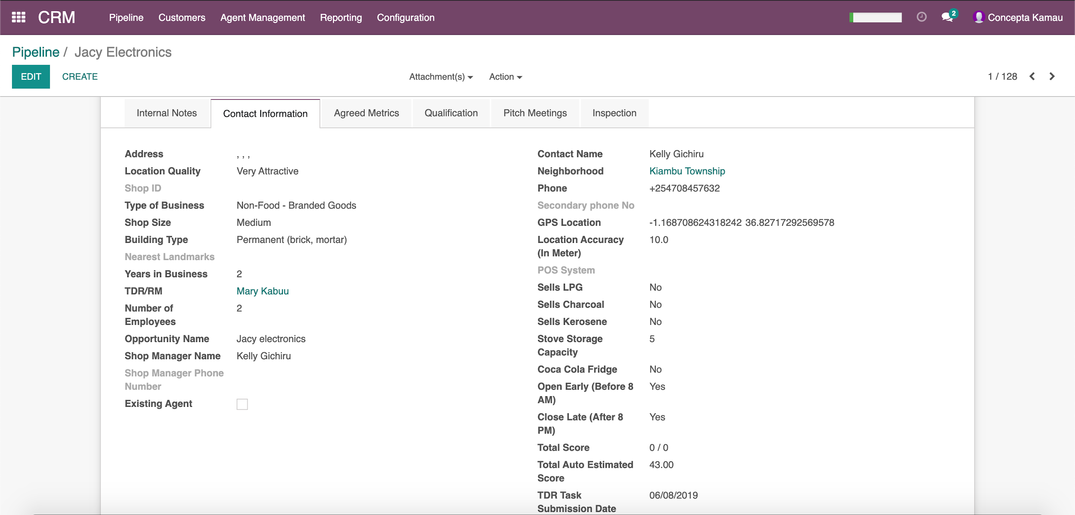
TDR TASK REVIEW COMPLETE
Once the TDR task has been updated, the information captured during the TDR task is updated in the
Opportunity’s contact information as per below.

Slide 19
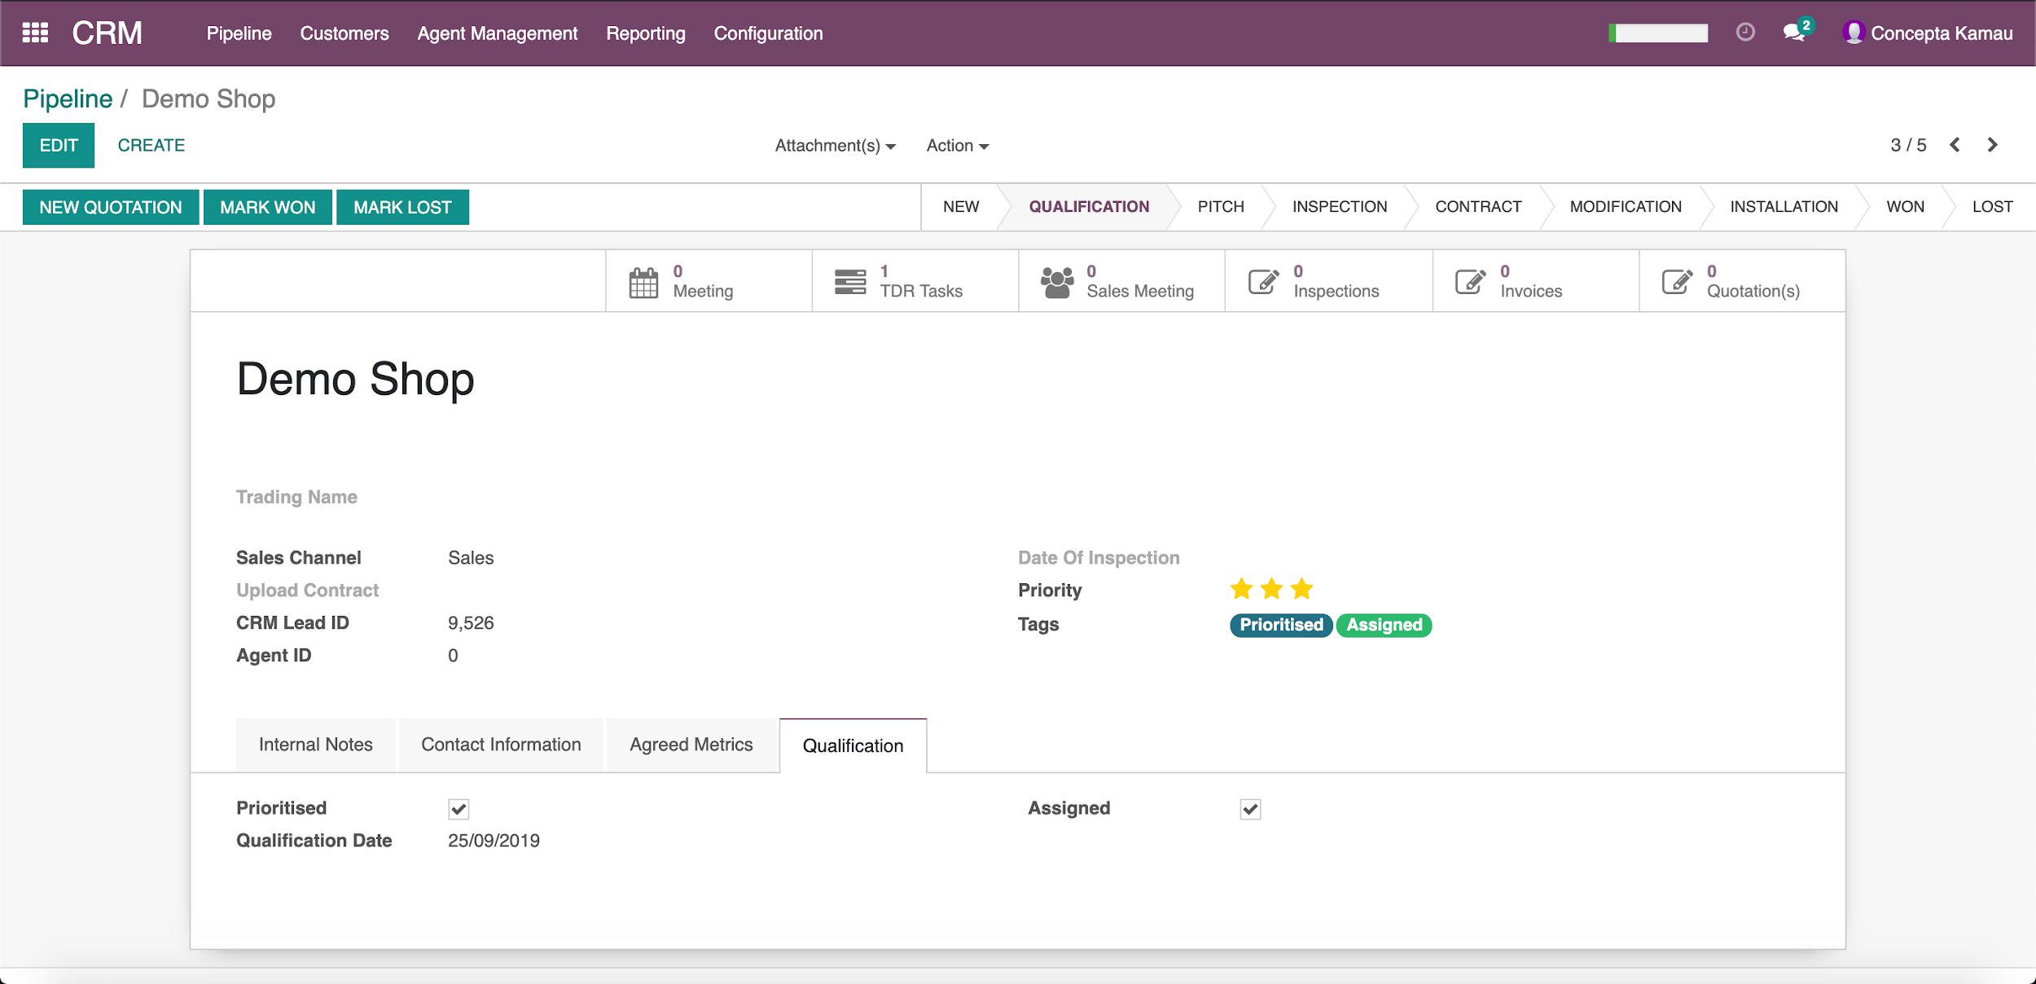
PRIORITIZING AND ASSIGNING
After reviewing the TDR Task→ Prioritize and mark as assigned.
The opportunity can be moved from Qualification to Inspection

Slide 20
PITCH STAGE ACTIVITIES
At Pitch stage the below activities are done by the TDR:
Enter/ create a new customer, putting in their name and phone number in the format +2547XXXXXXXX.
Always ensure to use the search functionality to confirm if the agent exists (if they have another KP in a different shop).
TDR pitches KOKO to the shop owner through Sales Meetings recorded in “Sales Meeting” menu.
An initial deposit KOKOpoint deposit (KSh. 2000) is mandatory, and the application form.
The scanned form, MPESA screenshot are attached and the boxes checked.
Check appropriate boxes- Application form, deposit paid and Demo (If the agent requests for a Demo, the TDR should organize that with respective RM and have it done)
Create an Agent security Deposit
NB: An opportunity will not move from Pitch to Inspection stage without customer name and phone number and agent security deposit.
When customer field is populated, it overwrites the fields “Contact Name”, “Secondary Phone number” and same in the Agent section under contact information. Where the contact person is different from shop owner, populate the details under “Shop Manager Name” and “Shop Manager Phone number”.

Slide 21
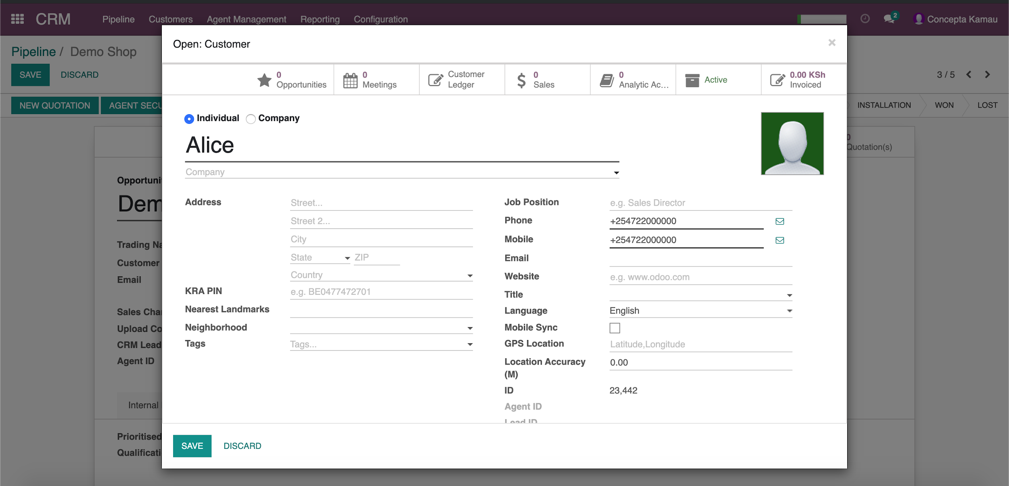
PITCH- UPDATE AGENT INFORMATION
Update customer information- Official Names, Mobile (MPESA) and Phone number (alternative), click Save

Slide 22
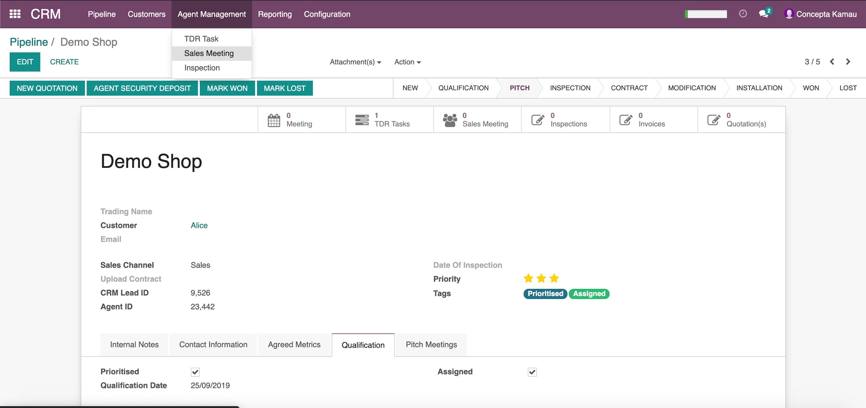
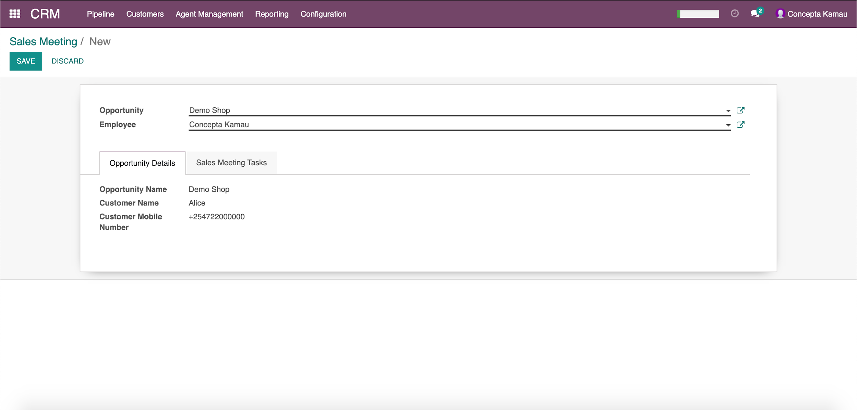
PITCH- CREATE SALES MEETING
Create Sales meeting by going to Agent Management→ Sales Meeting→ Create, enter Opportunity Name
and Employee (TDR) from drop down and save.

Slide 23
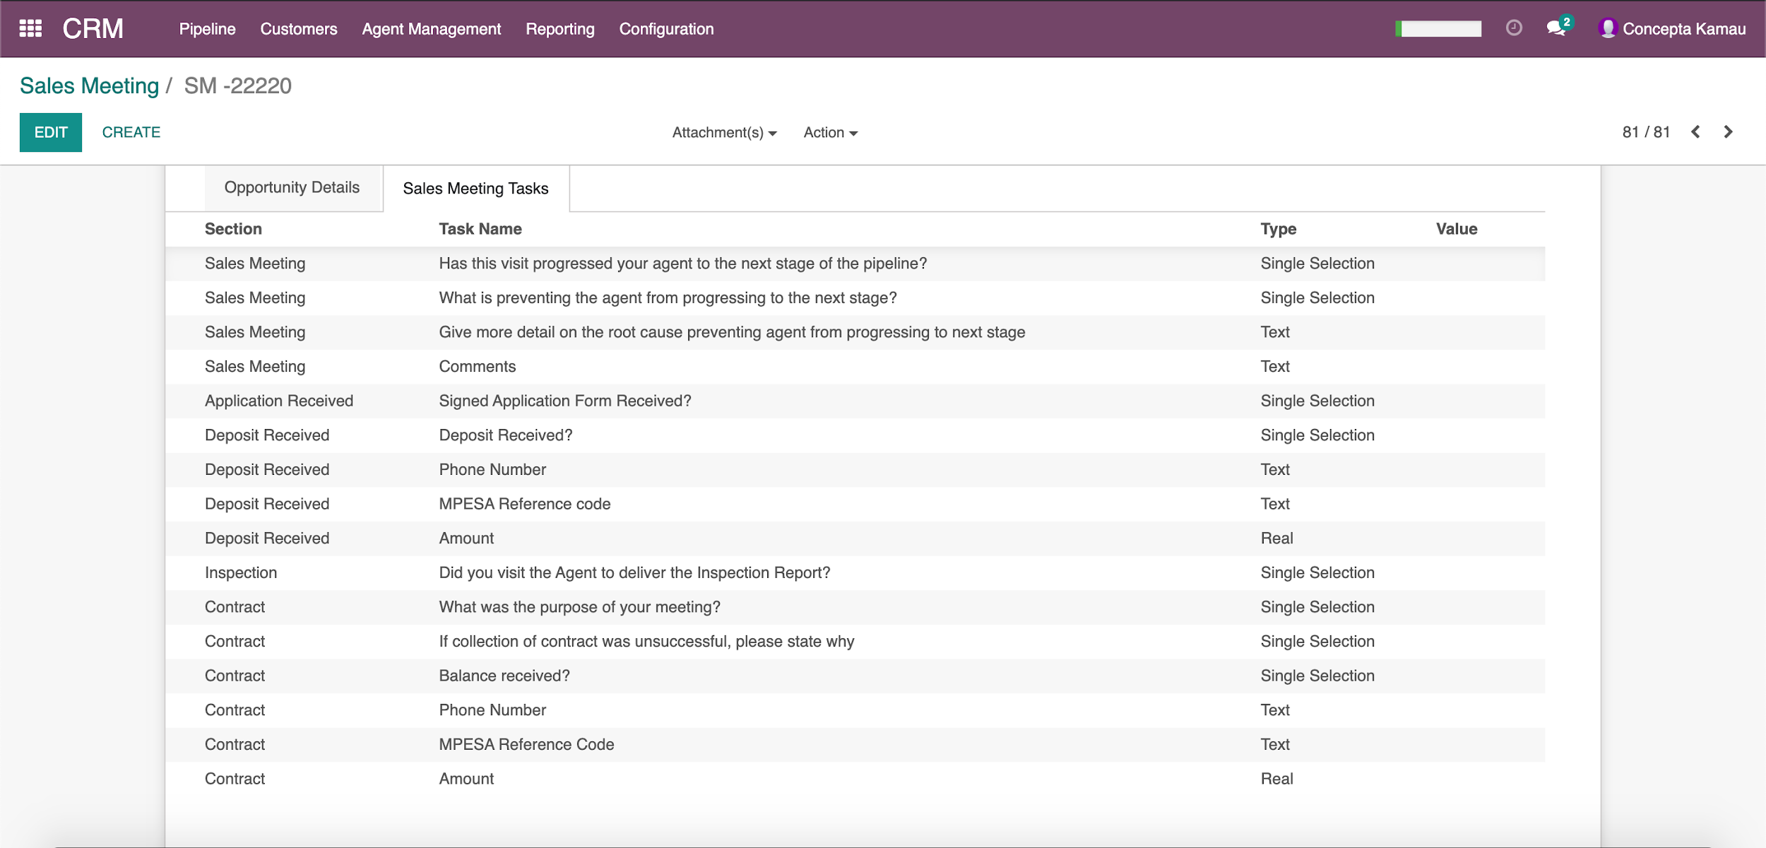
PITCH- SALES MEETING TASKS
Below are the questions to fill in a Sales Meeting task. They are not all mandatory, the answers vary on the
purpose of the meeting.

Slide 24
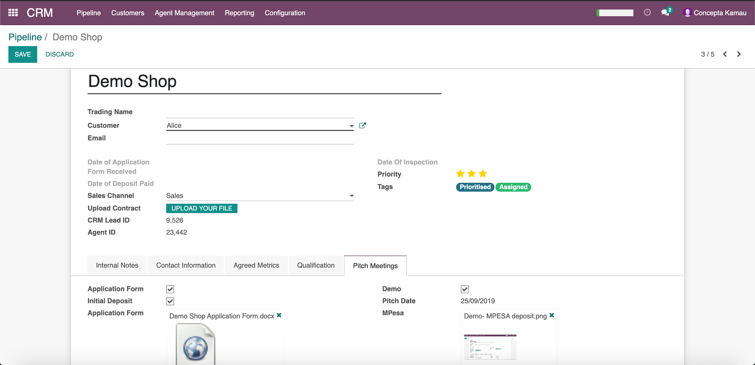
UPLOAD APPLICATION FORM AND DEPOSIT
Under submenu Pitch→ Attach Application form and the MPESA message screenshot

Slide 25
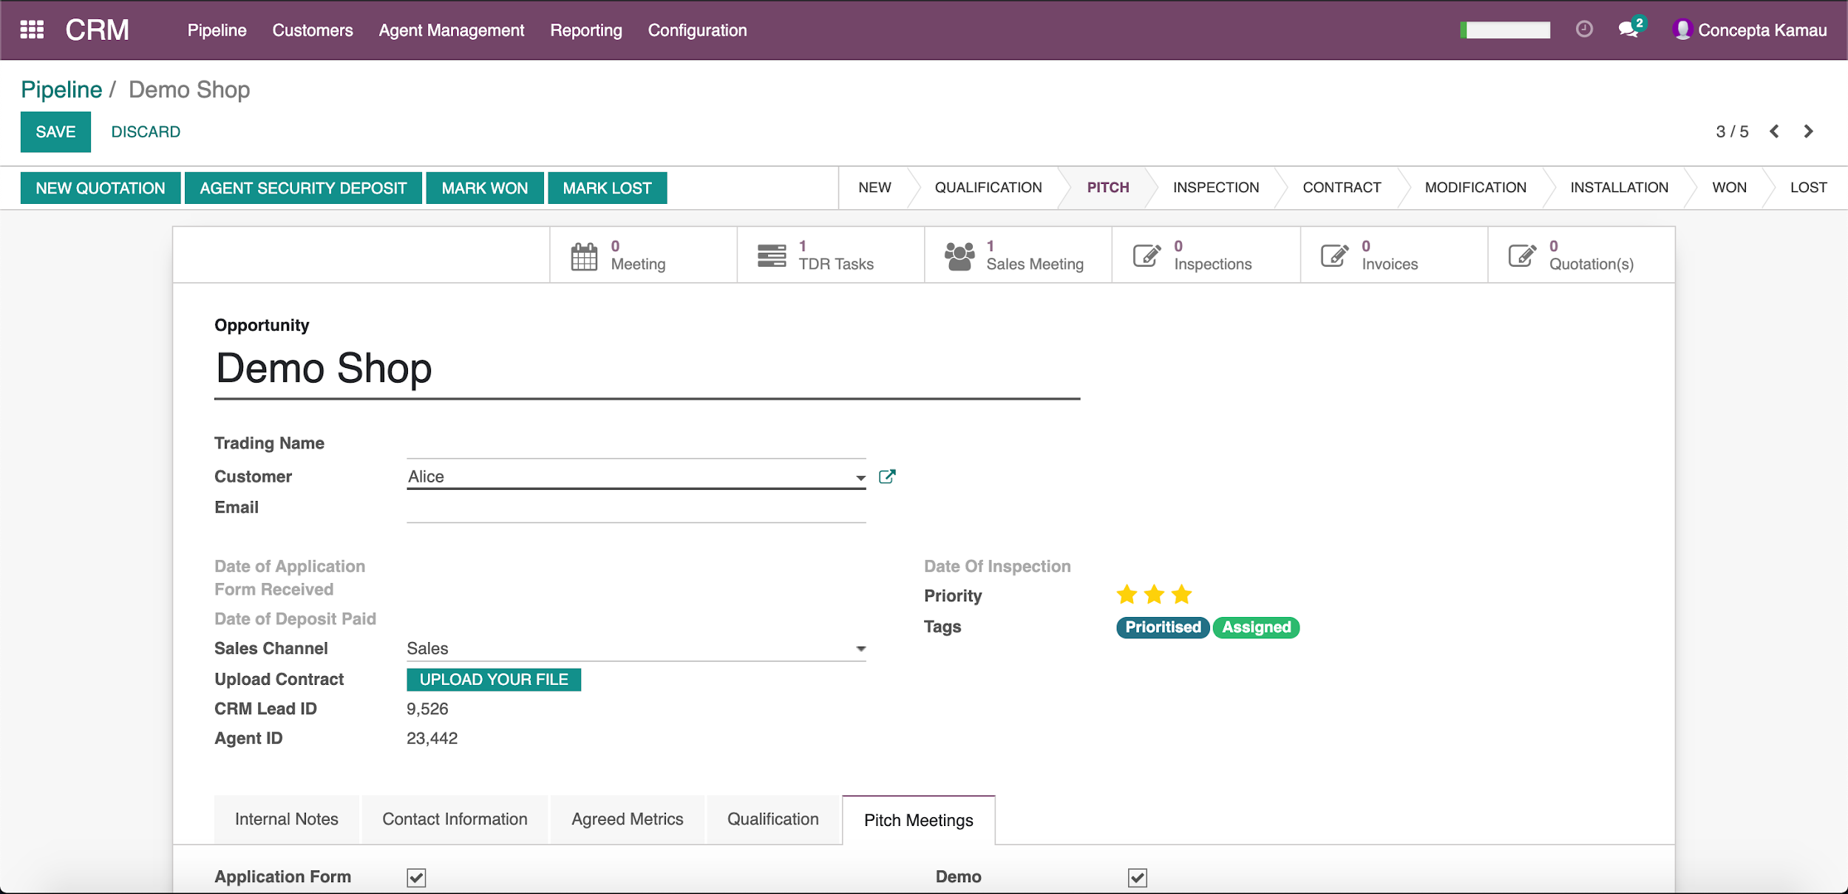
PITCH- AGENT SECURITY DEPOSIT
In the opportunity, click on the Agent Security Deposit, which Finance will use to register all
KOKOpoint deposits paid by the agent.

Slide 26
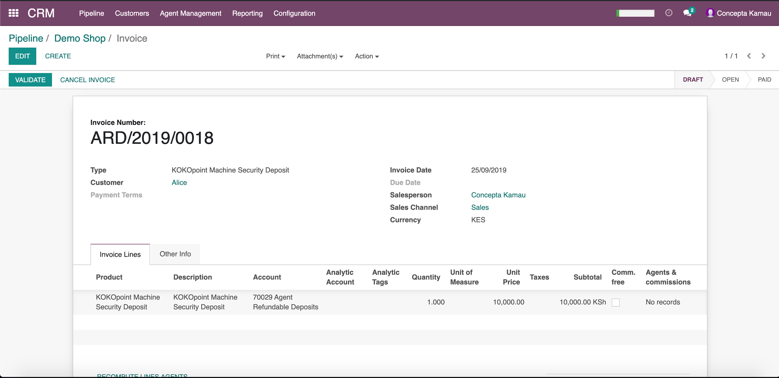
PITCH- AGENT SECURITY DEPOSIT
The Agent Security deposit looks like the below and should be left in Draft state
To go back to the opportunity, click on the name at the top left, under Pipeline menu

Slide 27
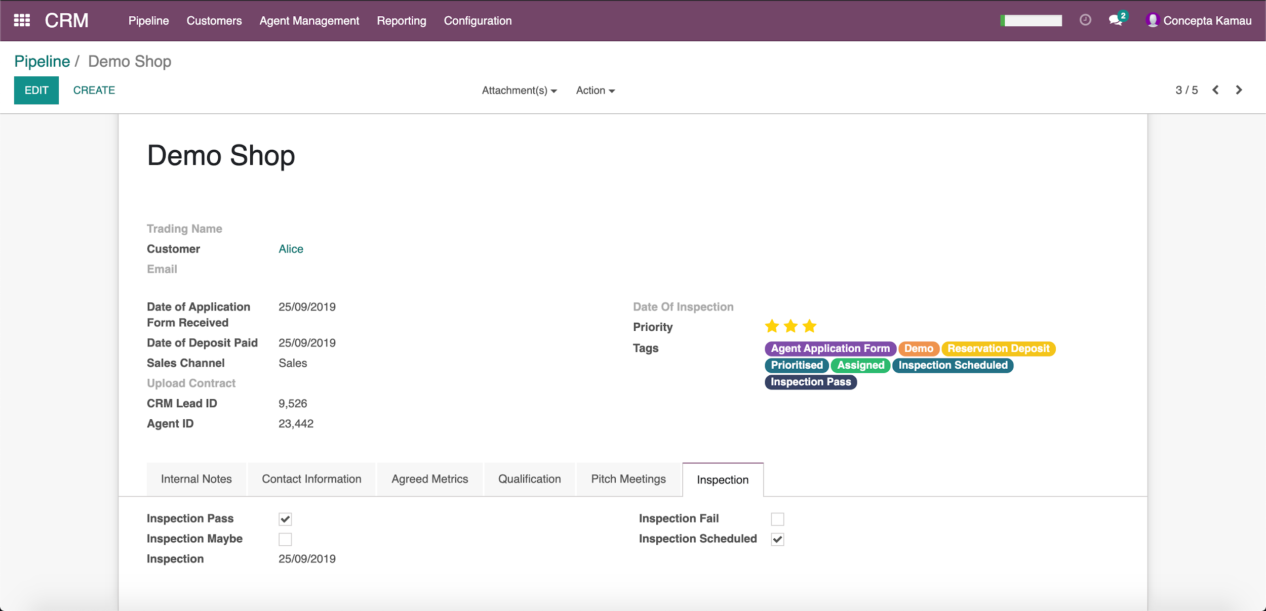
INSPECTION STAGE
The RM then captures if an inspection was scheduled, done and the outcome.
Inspection activity is currently managed outside the ERP.
and allow time to review, until opportunity is moved to contract stage.

Slide 28
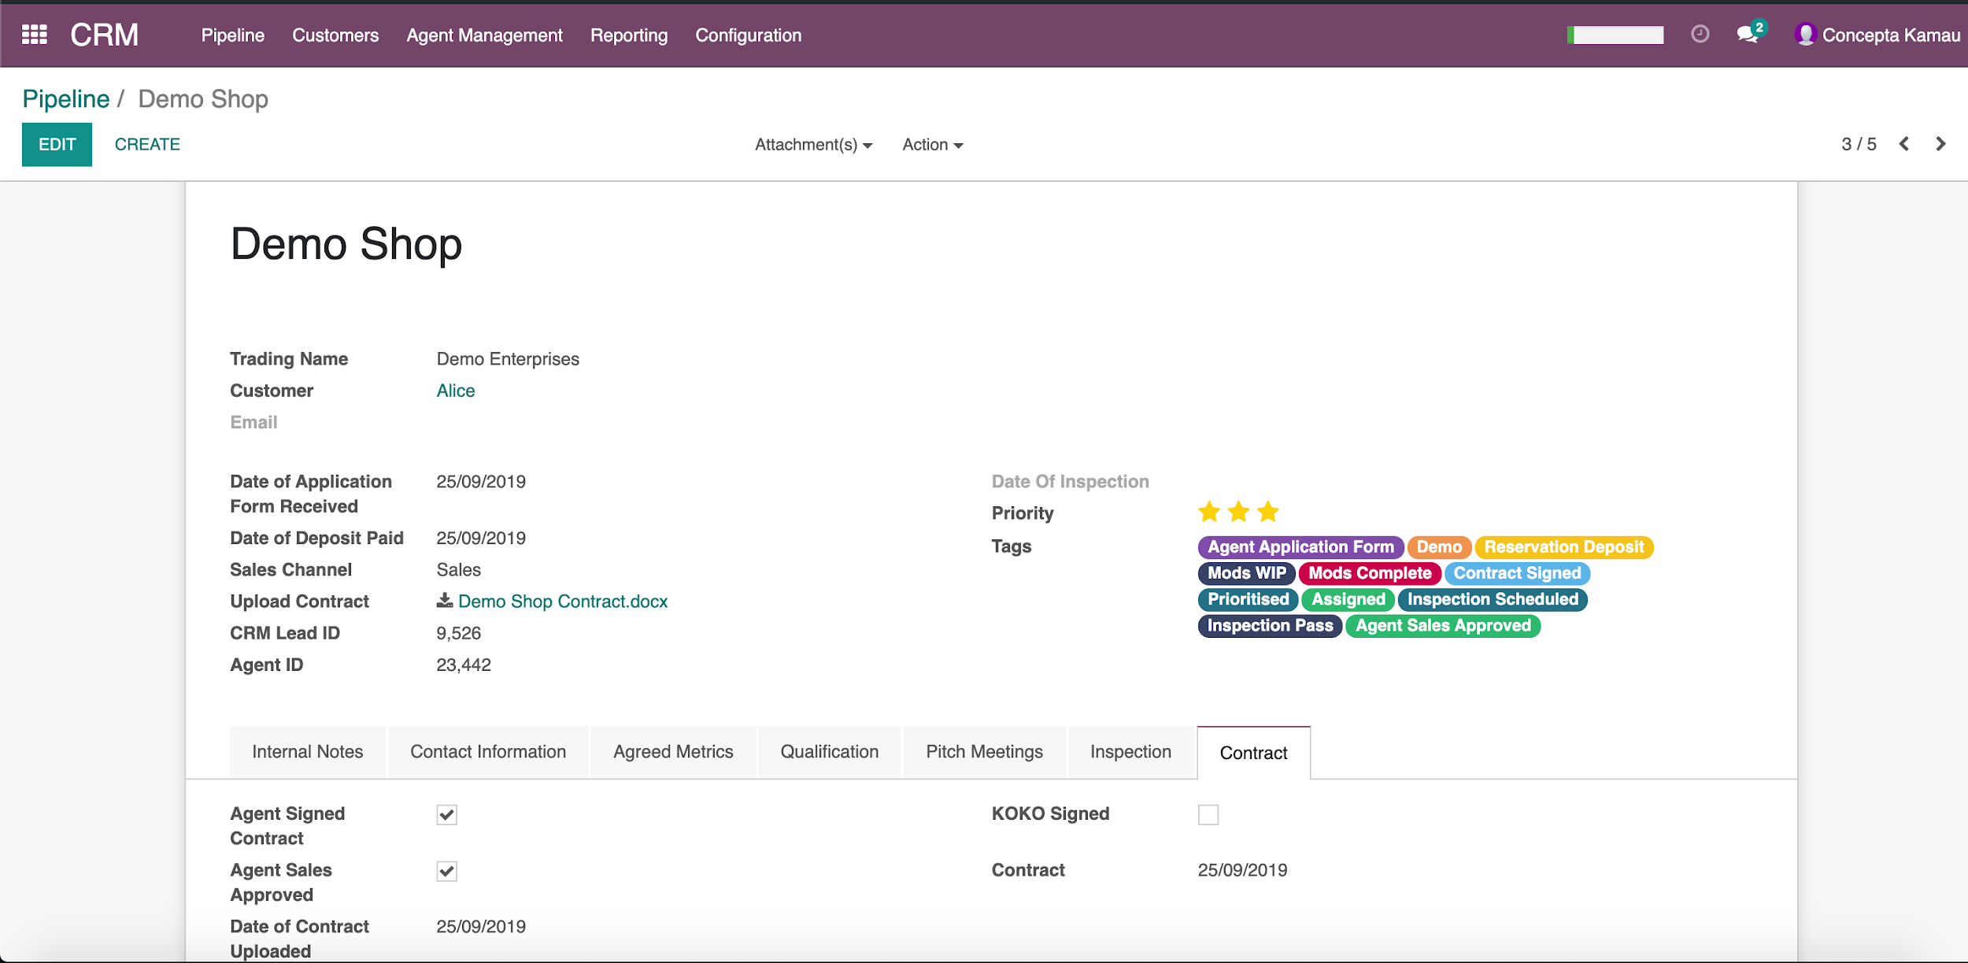
CONTRACT STAGE
The shop owner receives the contract, it’s read and signed, and KOKO countersigns.
The Trading name as per business permit is populated, beyond this stage, opportunity name becomes read-only.
Only users with the rights “Legal” can check the “KOKO signed box, after all KYC documents have been received.
Agent Sales approved means that the contract has been signed but KYC documents are not complete.

Slide 29
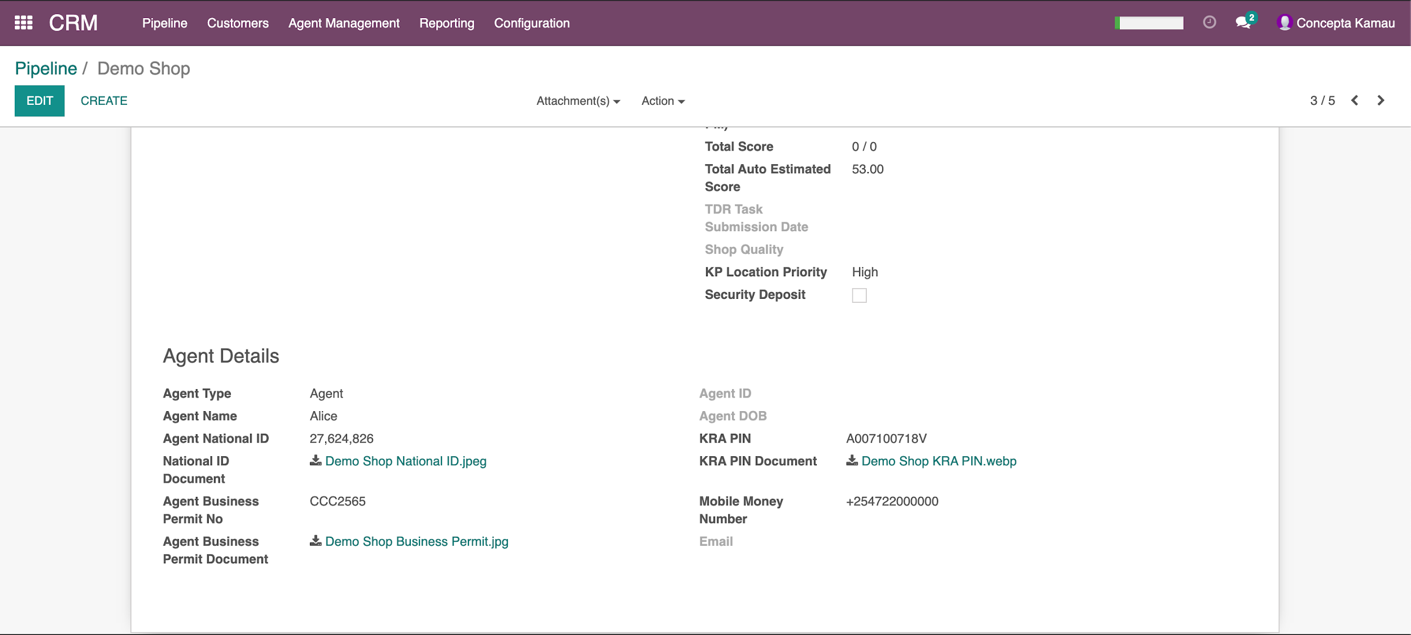
CONTRACT STAGE- KYC DOCUMENTS
All KYC documents received from the KOKO agent- KRA PIN, National ID and Business Permit should be
populated and attached under “Contact Information” in the section “Agent Details” at the very bottom

Slide 30
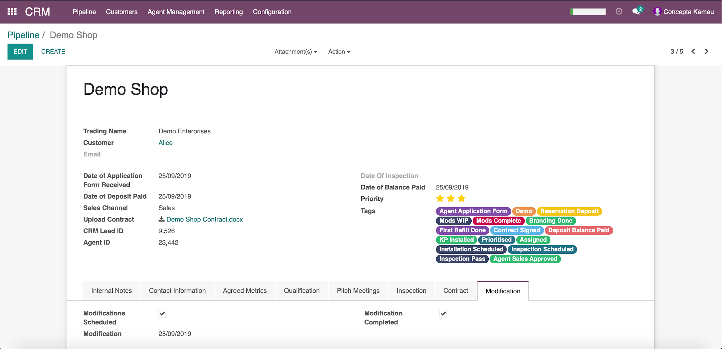
MODIFICATION STAGE
The RM captures modification activities that have been done accordingly. Mandatory boxes are
Modification scheduled and modification completed

Slide 31
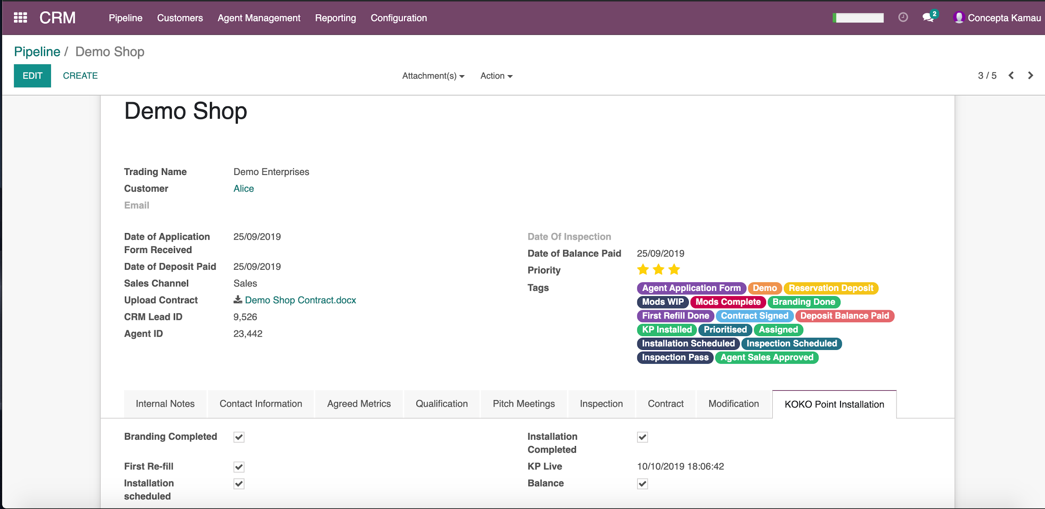
INSTALLATION STAGE
RM captures Installation activities- Installation scheduled, Branding, Installation complete, First Refill,
KP Live and Agent Security deposit balance paid.
The Security deposit balance must be fully paid for an opportunity to be marked as won.

Slide 32
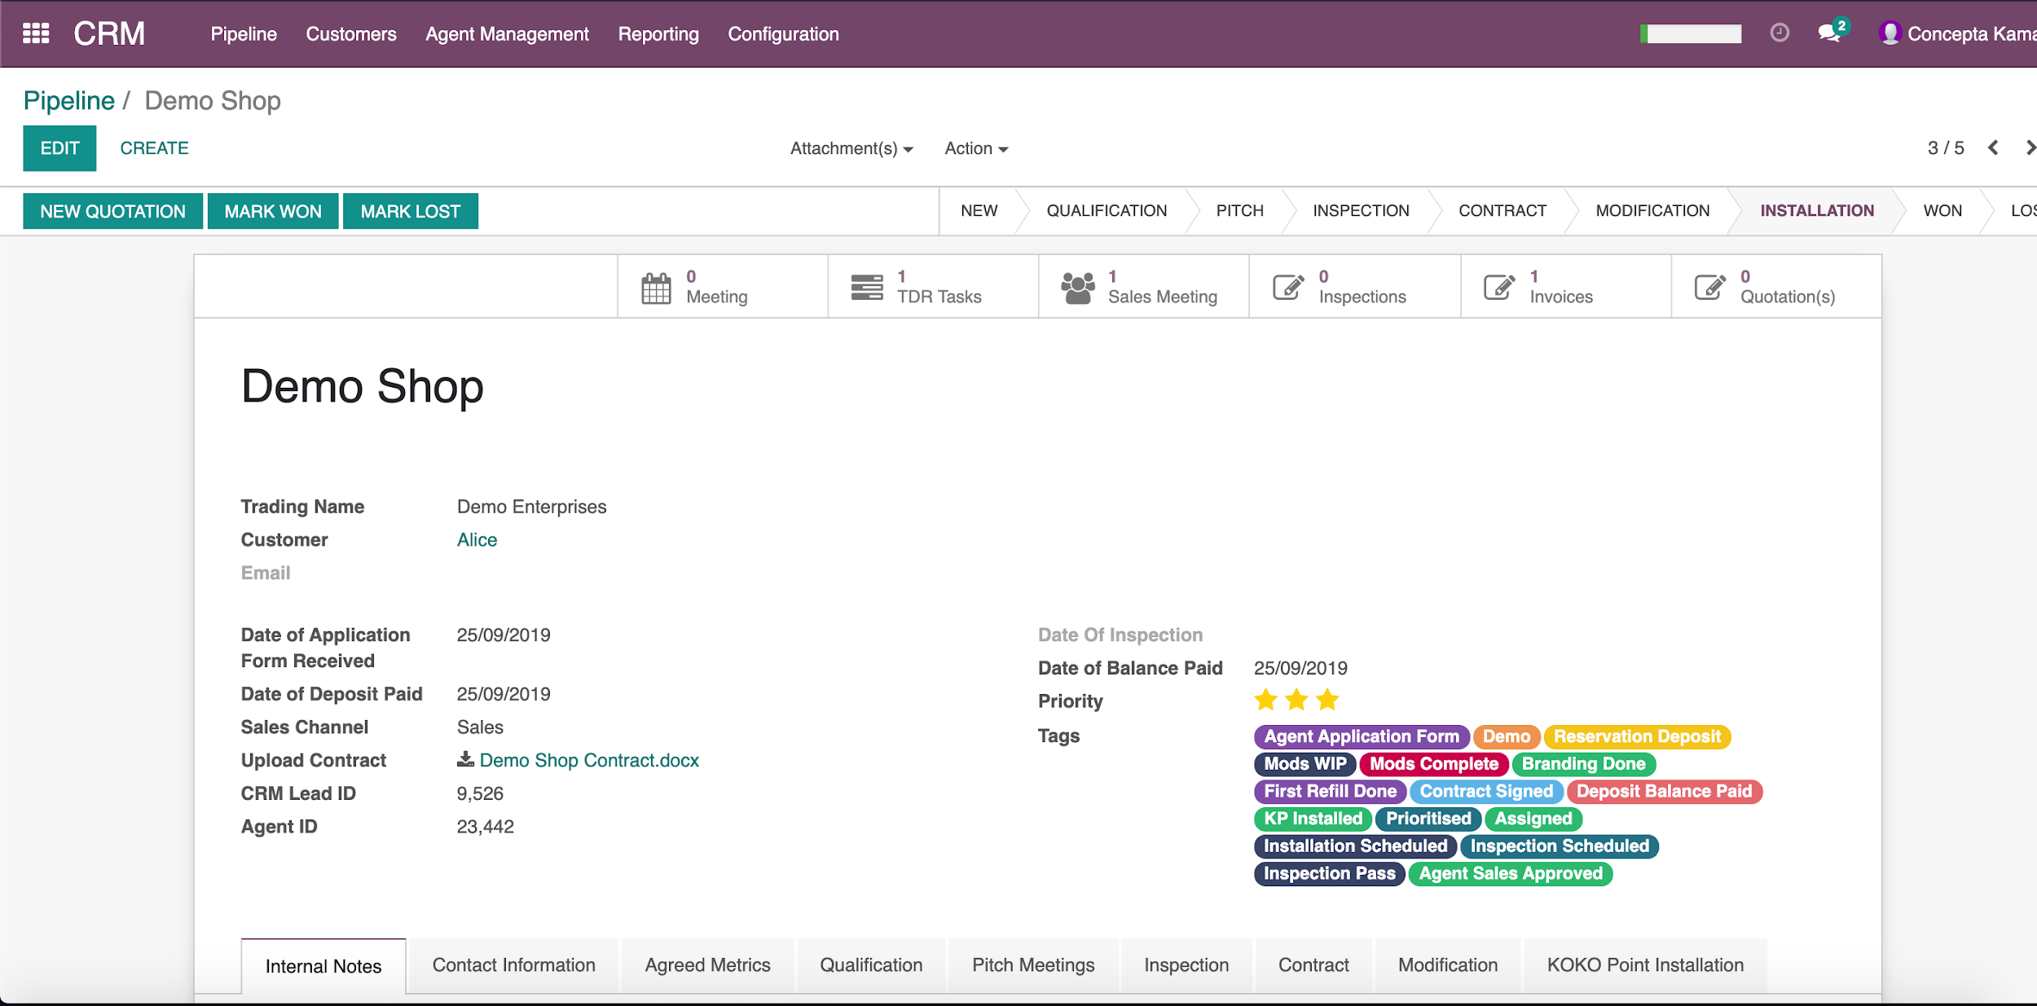
SUB MENU VIEW
The sub menu shows different activities and documentation that is related to the opportunity: TDR task,
Inspection tasks, Invoices (for agent security deposit)

Slide 33
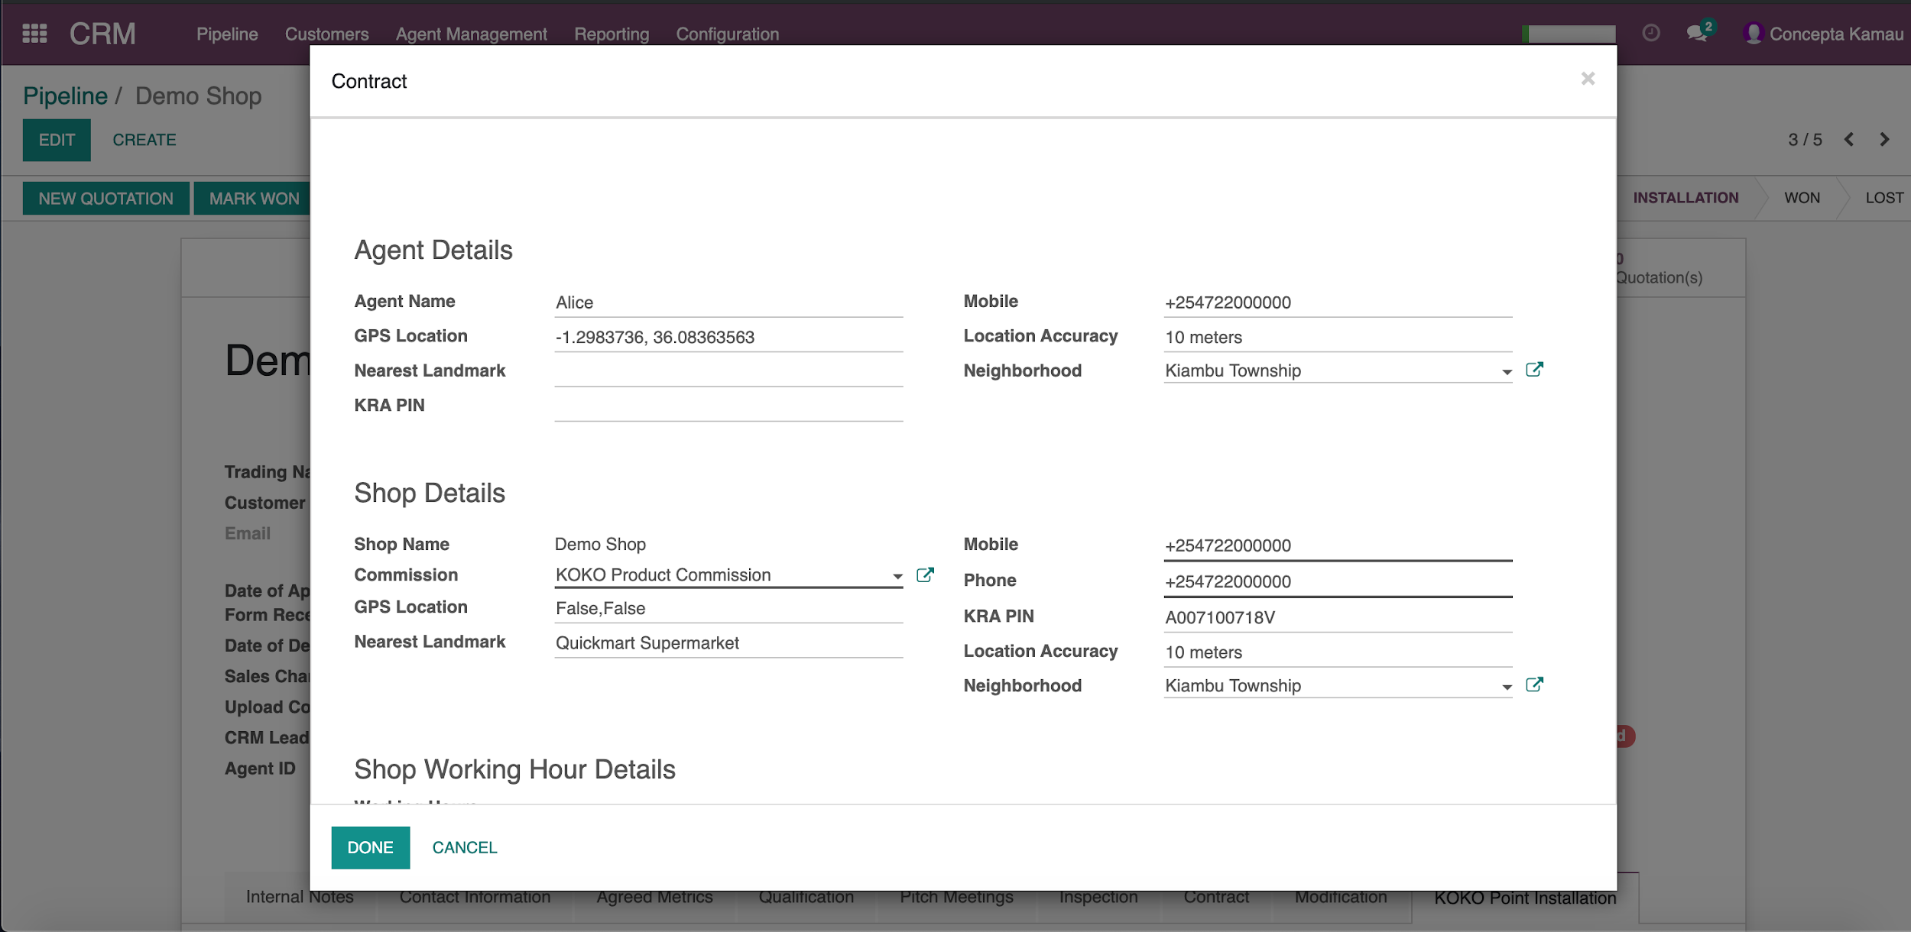
MARK AS WON
Marking an opportunity as won activates the global contract which manages the agent commissions and
rent calculations. Only authorised individuals can do this

Slide 34
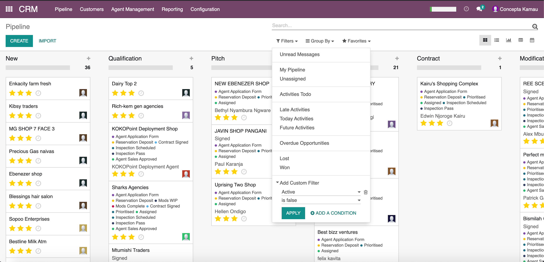
ARCHIVED OPPORTUNITIES
To view or recover an archived opportunity: Remove “My Pipeline filter”.
In Filters → Add custom filter → Active “is false” → Apply

Slide 35
ATTACHMENTS
Application Form
MPESA messages pictures
KYC Documents- KRA PIN, National ID and Business Permit.
KOKO signed Contract (Legal)

Slide 36
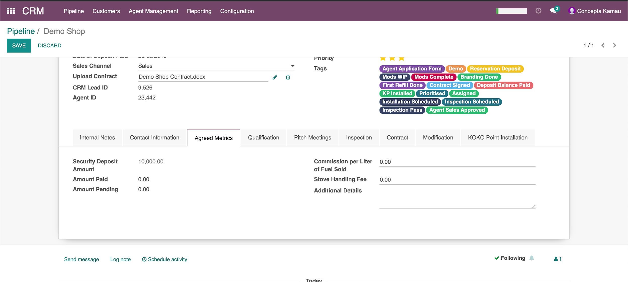
SEND MESSAGE/ LOG NOTE/ SCHEDULE ACTIVITY
Used to communicate to Odoo ERP users about a specific opportunity from within it.
Any user with access can schedule a personal activity from within Odoo- call, email, to do, meeting and put in personal notes

Slide 37
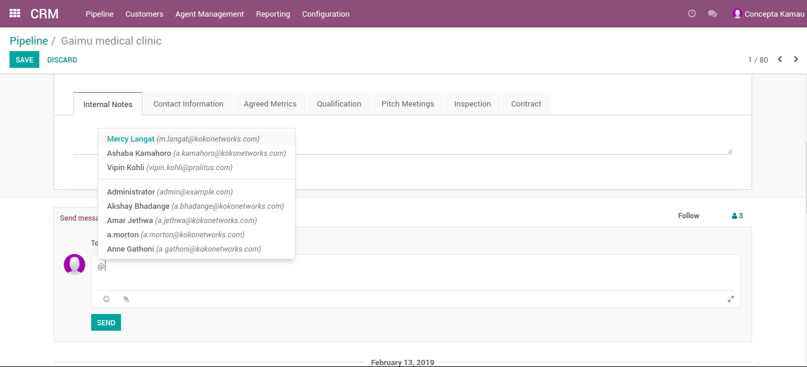
SEND MESSAGE
Use send message to send a message and notification to a TDR and all other followers of the Agent in
pipeline via email. Use @ sign to tag a specific person. It will create a log as well
Notes:
Use send message to send a message and notification to a TDR and all other followers of the Agent in pipeline via email. Use @ sign to tag a specific person. It will create a log as well

Slide 38
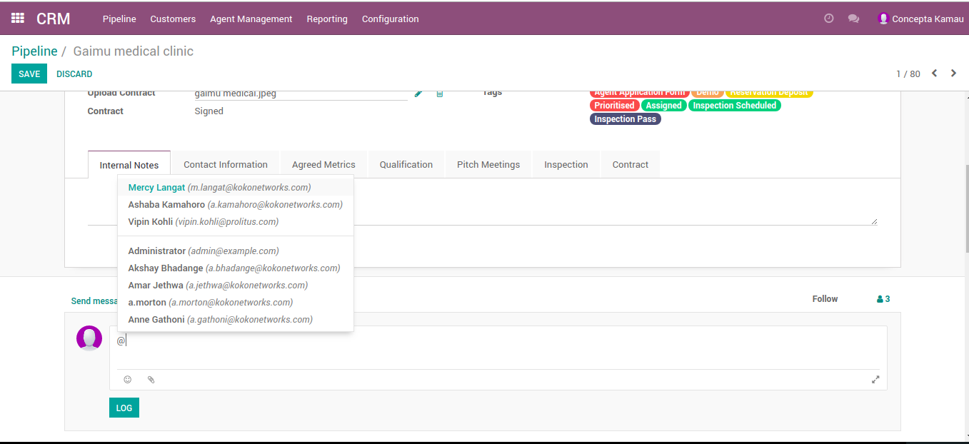
LOGGING NOTES
Use Log Note when you do not want a notification to be sent via email, but want it as a record under the
opportunity. You may still tag someone using @ sign
Notes:
Use Log Note when you do not want a notification to be sent via email, but want it as a record under the opportunity. You may still tag someone using @ sign

Slide 39

Q&A

